Slide 1






AtliQ Mart
Supply Chain
Performance Analysis
Report By:
Leveraging Power BI, SQL, and Excel for actionable insights across Gujarat’s FMCG deliveries
Subhojeet Sarkar

Slide 2
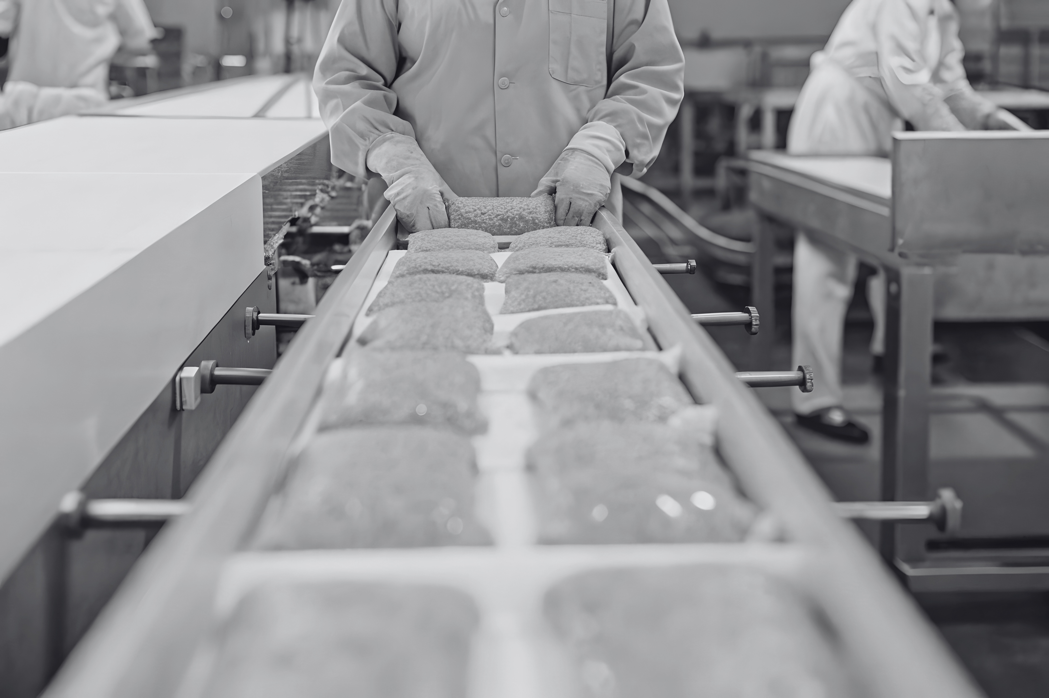




Presentation Outline
Company Overview
Problem Statement
Data & Methodology
KPI’s Definition
Dashboard Walkthrough
Critical Insights
Recommendations
Conclusion

Slide 3

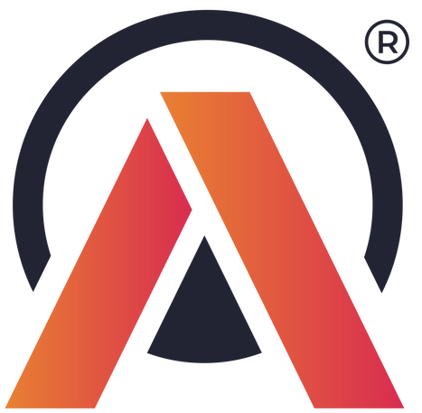






AtliQ Mart
Company
Overview
AtliQ Mart operates as an FMCG manufacturer based in Gujarat, India
Core operations focus on Surat, Ahmedabad, and Vadodara regions
Strategic goal: expand presence into Tier-1 cities within two years
Expansion requires robust supply chain processes for scalability
www.atliqmart.in
Understanding regional performance and operational challenges is critical to growth

Slide 4




Problem Statement
Delivery Challenges Impacting Customer Retention
AtliQ Mart is currently facing a problem where a few "key customers did not extend the annual contract due to service issues".
It is speculated that some of the essential products were either "not delivered on time" or "not delivered in Full Quantity" over a continued period, which could have resulted in bad customer service.
Management wants to fix this issue before expanding to other cities and requested their supply chain analytics team to track the ‘On time’ and ‘In Full’ delivery service level for all the customers on a daily basis so that they can respond swiftly to these issues.

Slide 5






Data & Methodology
Integrating and validating multiple data sources for precise supply chain insights
Integrated six distinct CSV datasets for comprehensive analysis
Cleaned and transformed data using Power Query within Power BI to ensure quality and consistency
Modeled relationships among data entities in Power BI’s data model for robust analytical capability
Validated and computed key performance indicators with SQL queries for accuracy
Calculated advanced metrics including COCT, LIFR%, and VOFR% using DAX formulas

Slide 6
Key KPIs Defined
On-Time Delivery Percentage (OT%) tracks the punctuality of product arrivals, ensuring schedule adherence.
Volume Fill Rate (VOFR%) measures inventory fulfillment efficiency by shipment volume, optimizing load utilization.
In-Full Delivery Percentage (IF%) measures order completeness, reflecting how fully customer orders are met.
Measuring Supply Chain Performance for Operational Excellence
Line Fill Rate (LIFR%) quantifies inventory fulfillment efficiency at the product line level.
Average Delivery Delay highlights delays beyond expected timelines, guiding targeted operational improvements.
Customer Order Cycle Time (COCT) tracks the speed from order placement to delivery, reflecting process efficiency.
On-Time-In-Full (OTIF%) combines timeliness and completeness to assess overall delivery performance.

Slide 7
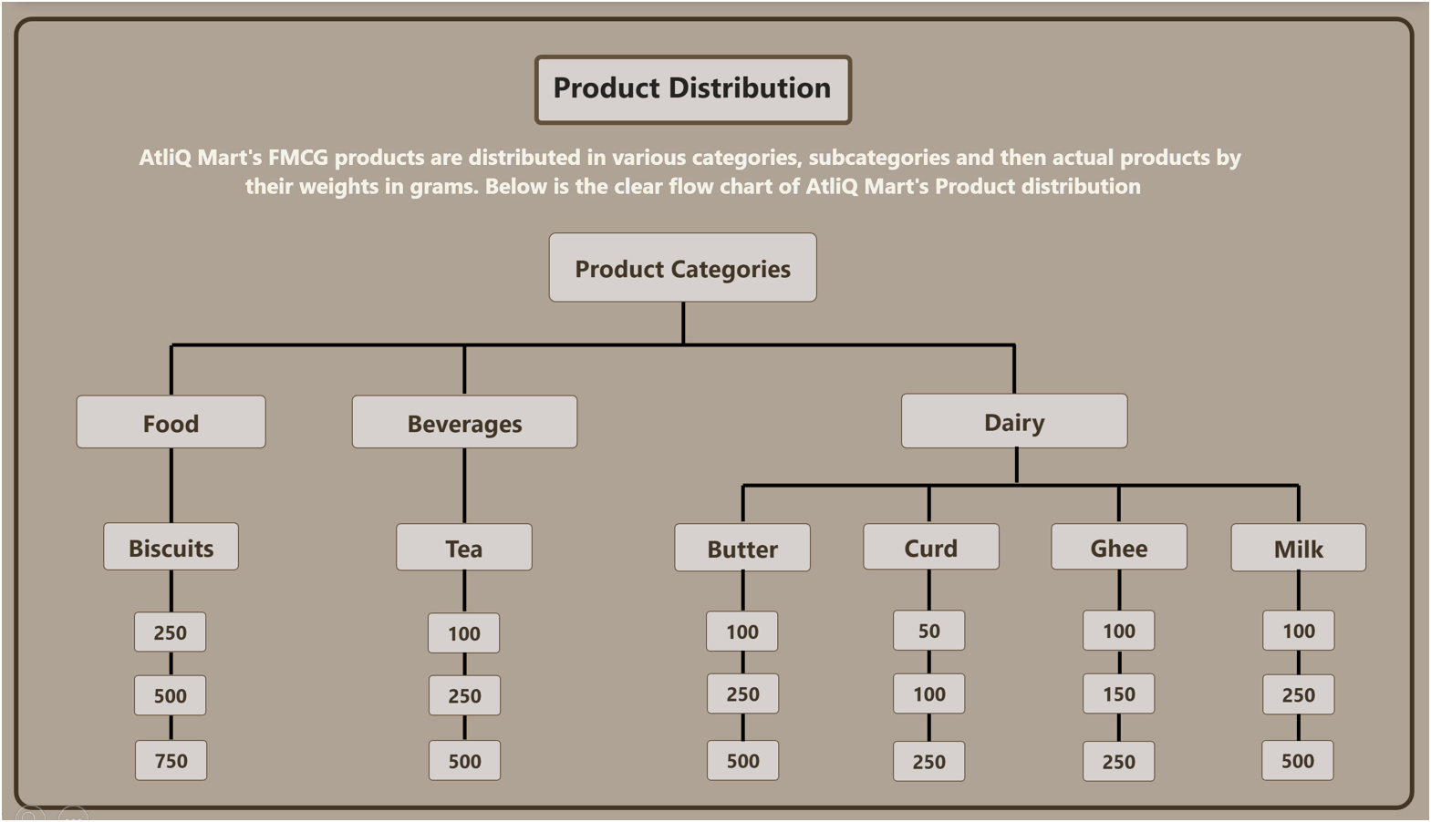



Slide 8
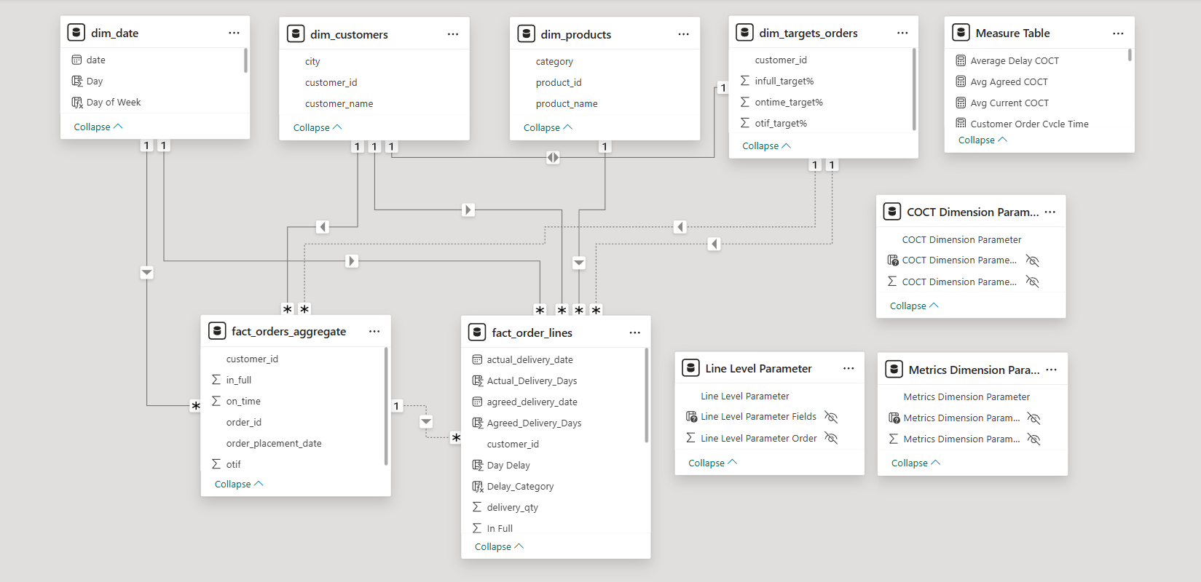















Model View

Slide 9
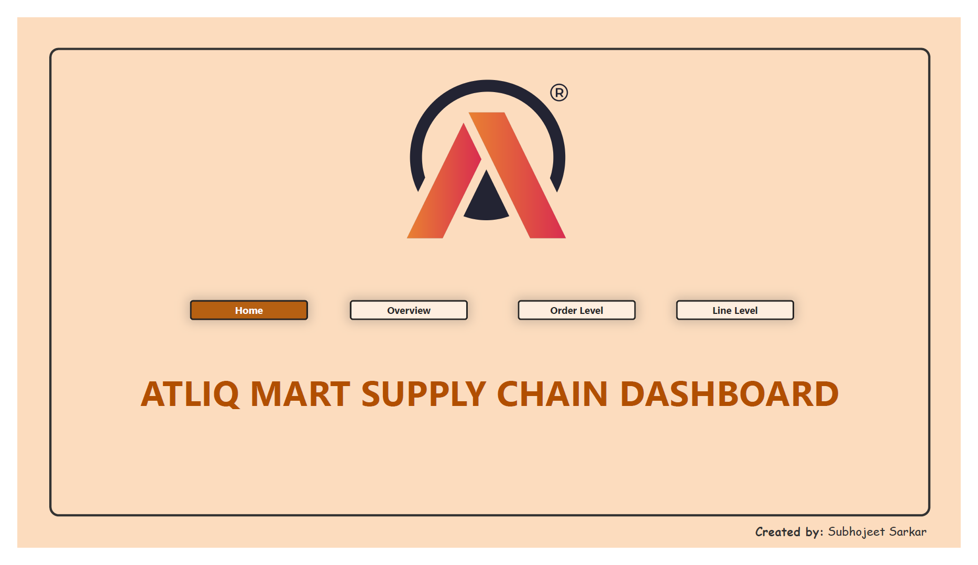
Home

Slide 10
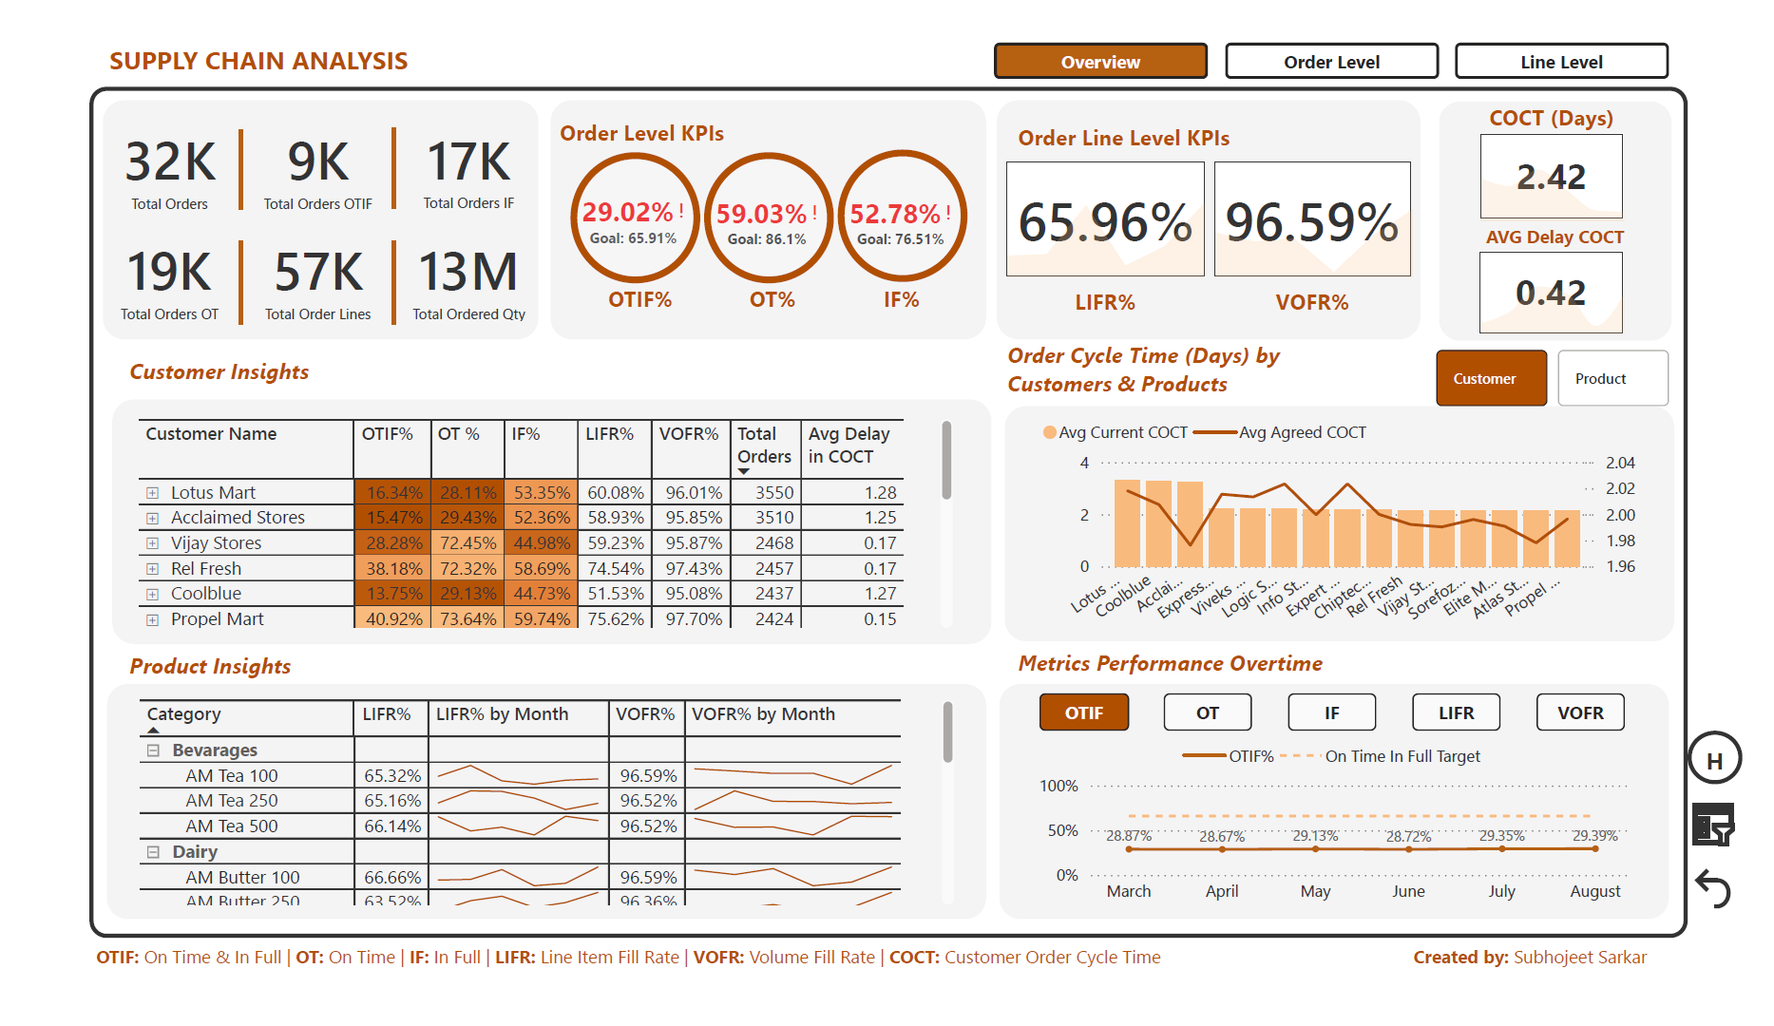
Overview

Slide 11
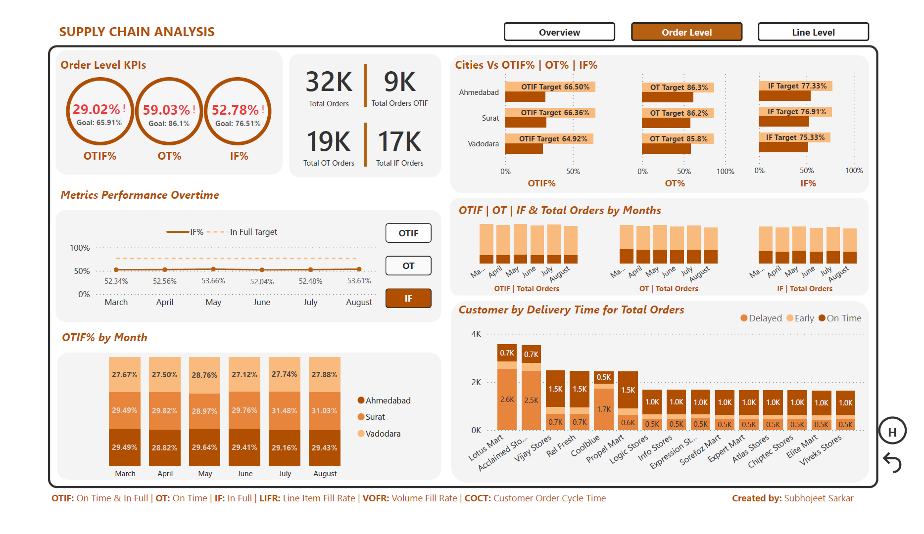
Order Level

Slide 12
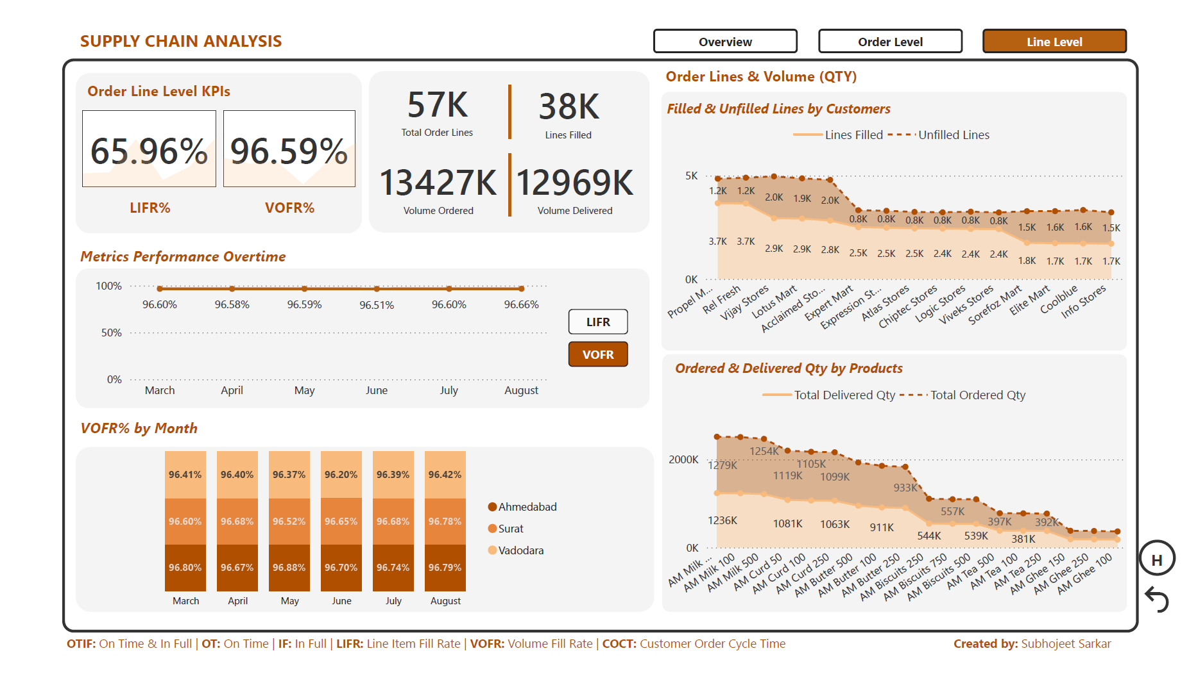
Line Level

Slide 13


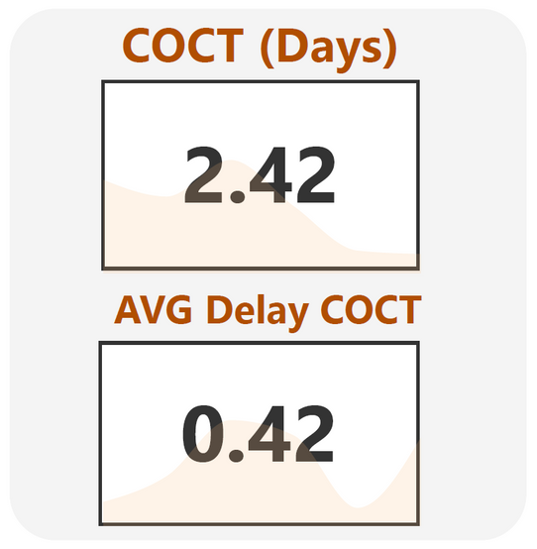
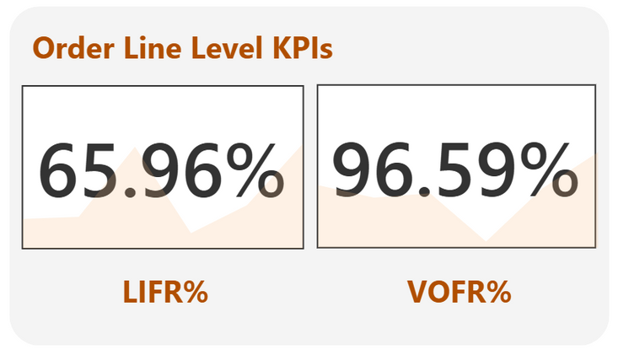


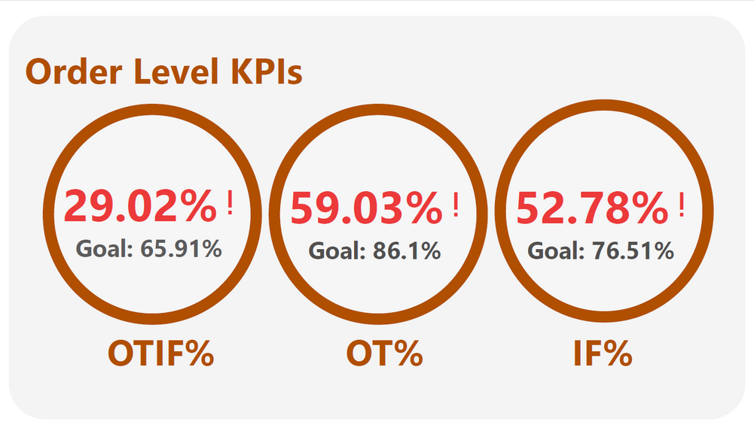


Overall Service Performance
All key metrics (OT%, IF%, OTIF%) are significantly below target — lagging by 25–35% on average.
Despite consistent operations, there’s no visible improvement in these KPIs over recent months.
Average delivery delay is around 0.42 days, and average order cycle time is 2.42 days.

Slide 14
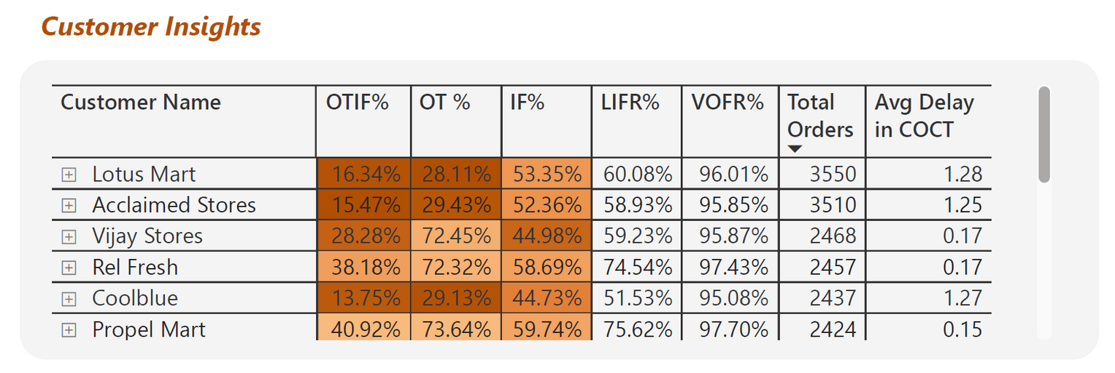
Customer-Level Insights
Lotus Mart, Coolblue, and Acclaimed Stores placed the most orders but have the poorest delivery performance indicating operational inefficiency or poor planning.
Lotus Mart’s OTIF% = 16.34% and On-Time% = 28.11% — far below target. Immediate corrective action is required to prevent customer churn.
Propel Mart is the most efficient customer with same-day delivery (0.15 days) and the highest satisfaction rate.
Top 6 customers account for over 50% of total orders, making them strategically important for retention and service optimization.

Slide 15
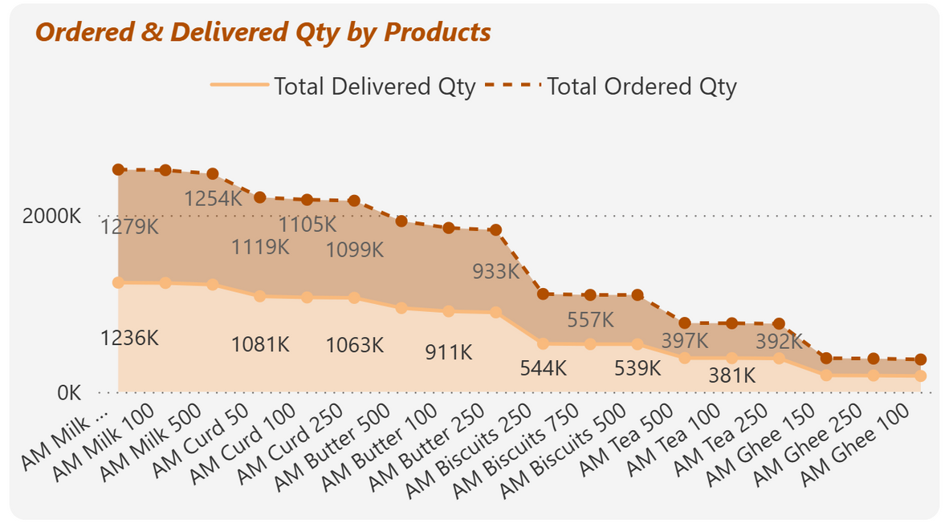
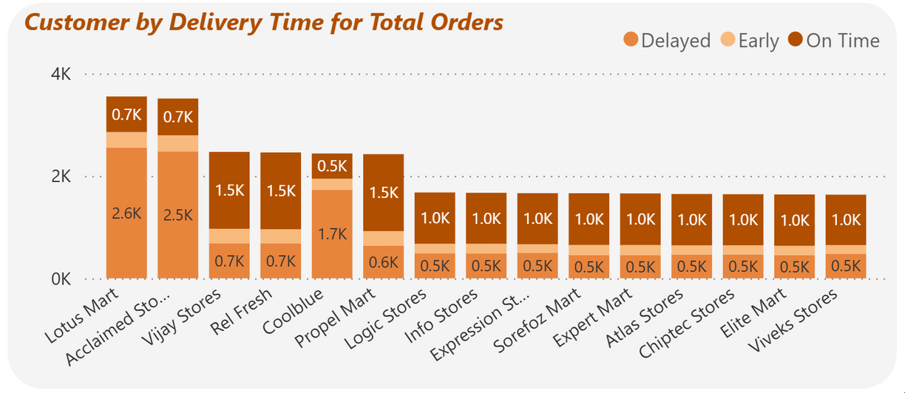
Product-Level Insights
Dairy is the highest-revenue category but suffers from frequent delivery delays.
Ghee, Curd, and Butter are the most delayed products — likely due to inventory shortages or cold-chain inefficiencies.
AM Butter 500 is the most ordered item; AM Milk 100 has backlog issues, suggesting skewed demand planning.
Biscuits 750 shows the highest LIFR, meaning orders are fulfilled completely, though not always on time.

Slide 16
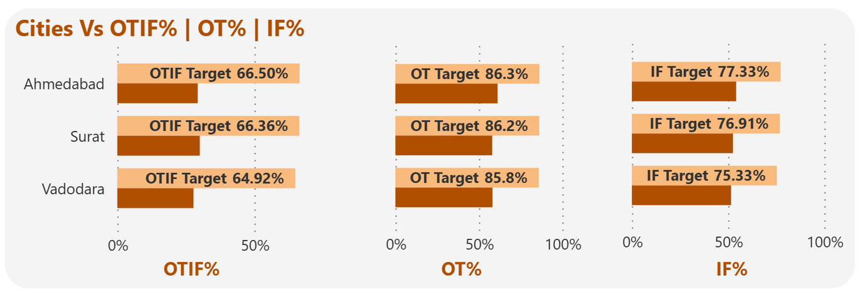
City-Level Analysis
Vadodara shows the weakest service level, followed by Ahmedabad and Surat.
In all three cities, OTIF% never reaches target lines — indicating systemic supply chain inefficiencies, not isolated customer issues.

Slide 17
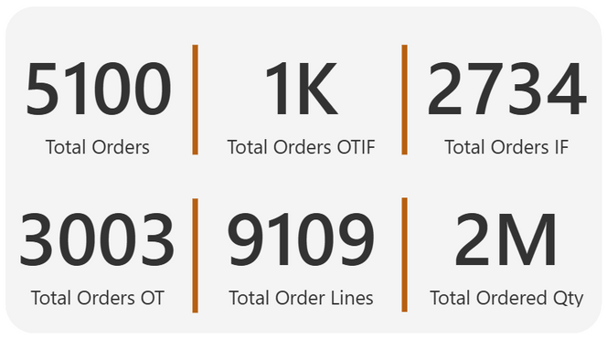
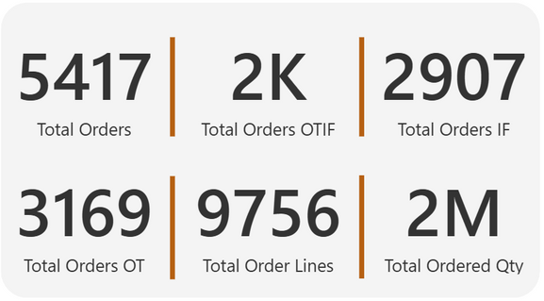
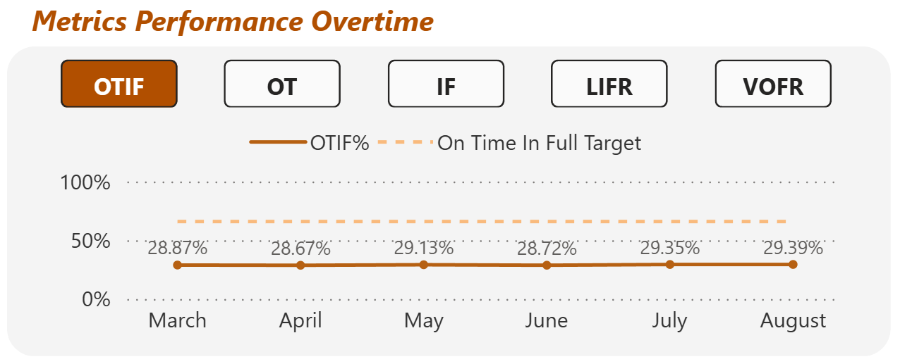
Time-Based Performance
May
May had the highest delivered volume, while August recorded the lowest — possibly due to logistics or seasonal demand issues.
August
No day in the dataset reached the target for OTIF%, proving consistently poor reliability.
Daily trends reveal performance fluctuations, with no corrective trend visible.

Slide 18

Key Performance Observations
Overall Service Performance
All primary KPIs (OT%, IF%, OTIF%) lag by approximately 30% against targets, highlighting major service gaps
Customer-Level Insights
City-Level Analysis
Lotus Mart, Acclaimed Stores, and Coolblue identified as the lowest performing customers in service delivery
Vadodara city reports the worst customer experience, signaling a key geographic pain point
Product-Level Insights
Time-Based Performance
Dairy product lines—Ghee, Butter, and Curd—are primary contributors to delivery delays
No significant month-over-month improvements detected, confirming persistent operational challenges needing urgent focus

Slide 19



Root Cause Hypotheses
Inefficient production planning
Distribution center constraints
leading to stock-outs and partial deliveries (low IF%)
limited vehicle or manpower capacity in certain regions
Inaccurate delivery scheduling
Overwhelming logistics
High order volume from select key customers (Lotus Mart, Acclaimed Stores)
misalignment between agreed vs. actual delivery dates (low OT%)

Slide 20




Actionable Recommendations
AtliQ Mart
Delivery Planning
Customer Prioritization
Optimize warehouse dispatch and transport scheduling to minimize delivery delays (+15% improvement in OT%)
Assign dedicated service SLAs to high-volume customers for prioritized handling (Prevent churn)
Inventory Management
Performance Monitoring
Demand Forecasting
Maintain safety stock for top dairy SKUs to reduce stockouts and ensure availability (+10% improvement in IF%)
Implement an early warning system to proactively flag potential late shipments (Early issue detection)
Enhance coordination between inventory management and logistics to improve order completeness (Reduced late shipments)

Slide 21
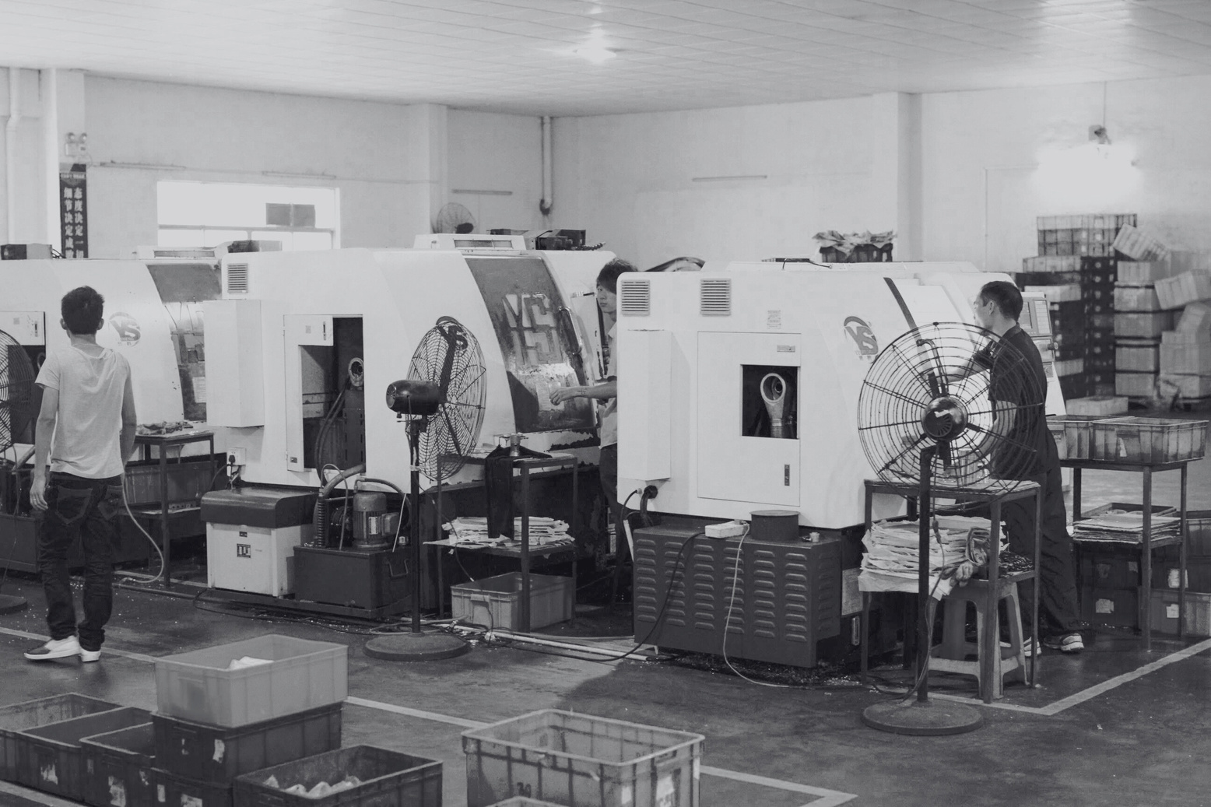





Tools Used for Comprehensive Analysis
Integrated BI and data manipulation tools driving AtliQ Mart’s supply chain insights
Power BI: Visualization and dashboard creation for interactive reporting
SQL: Data querying and validation across multiple sources
Power Query: Data cleaning and transformation to ensure accuracy
DAX: Advanced metric computations enabling deep performance insights
Excel: Supplementary data analysis and manual review support
Canva: PowerPoint Presentations with slides

Slide 22








This analysis translates AtliQ Mart’s operational data into actionable business insights to enhance service and support market expansion.
Leveraging data analytics is essential to sustain a competitive advantage in the fast-moving consumer goods (FMCG) sector.
Conclusion
Connect with Subhojeet Sarkar for ongoing collaboration via GitHub, LinkedIn, or email.

Slide 23


Thank You

